Slide 1



UE20CS390A
Capstone Project Approval
Project Title : Build platform to Dockerize eox microservices
Project ID : PW_23_VP_01
Project Guide : Prof Venkatesh Prasad, Vijay R(EOX Vantage)
Project Team :
Yuvaraj DC PES1UG20CS521
Veena Garag PES1UG20CS492
Adarsh Kumar PES2UG20CS016
Suchit S Kallapur PES1UG20CS438

Slide 2
Container and Kubernetes
Outline
Problem Statement
Scope and Feasibility study
Applications/Use cases
Expected Deliverables
Capstone (Phase-I & Phase-II) Project Timeline
Any other information

Slide 3
Container and Kubernetes
Problem Statement
Well defined problem statement
In simple words to say we are given a monolithic application. we need to decompose into microservices and deploy on docker locally and moving to kubernetes.
Kubernetes access to Cloud Provider API encryption
As Kubernetes is entirely API driven, controlling and limiting who can access the cluster and what actions they are allowed to perform is the first line of defense.
Kubernetes expects that all API communication in the cluster is encrypted by default with TLS, and the majority of installation methods will allow the necessary certificates to be created and distributed to the cluster components. Note that some components and installation methods may enable local ports over HTTP and administrators should familiarize themselves with the settings of each component to identify potentially insecure traffic.
We aim to understand the architecture and different microservices of the application and deploy the applications in Kubernetes to ensure high availability and scalability.

Slide 4
Container and Kubernetes
Scope and Feasibility study
Scope :
Dockerize EOX microservices.
Deploy EOX microservices to a Kubernetes clusters.
This research and implementation is used to reduce the life-cycle of deployment of the finished containers into cloud.
Using AWS EKS to run Kubernetes on AWS without needing to install, run or maintain Kubernetes control plane.
Possible Shortcomings/Challenges :
Reducing costs.
Migration from dockers to kubernetes.
Maintaining load while scaling(Load Balancing and Scaling).
Secure communication among the containers.

Slide 5
Container and Kubernetes
Applications/Use cases
Describe the applications and use cases of your project.
containerized microservices
improved efficiency of the servers, scalability, load balancing
reduces the costs, easy deployments and maintenance
more secure, multitenancy support
improvement in software testing

Slide 6
Container and Kubernetes
Expected Deliverables
Capstone-I deliverables
Deploying of docker containers locally
Detailed study of architectural design
Literature survey
Capstone-II deliverables
Implementation of the architecture.
Testing locally.
Deployment to the cloud and testing while load balancing.

Slide 7
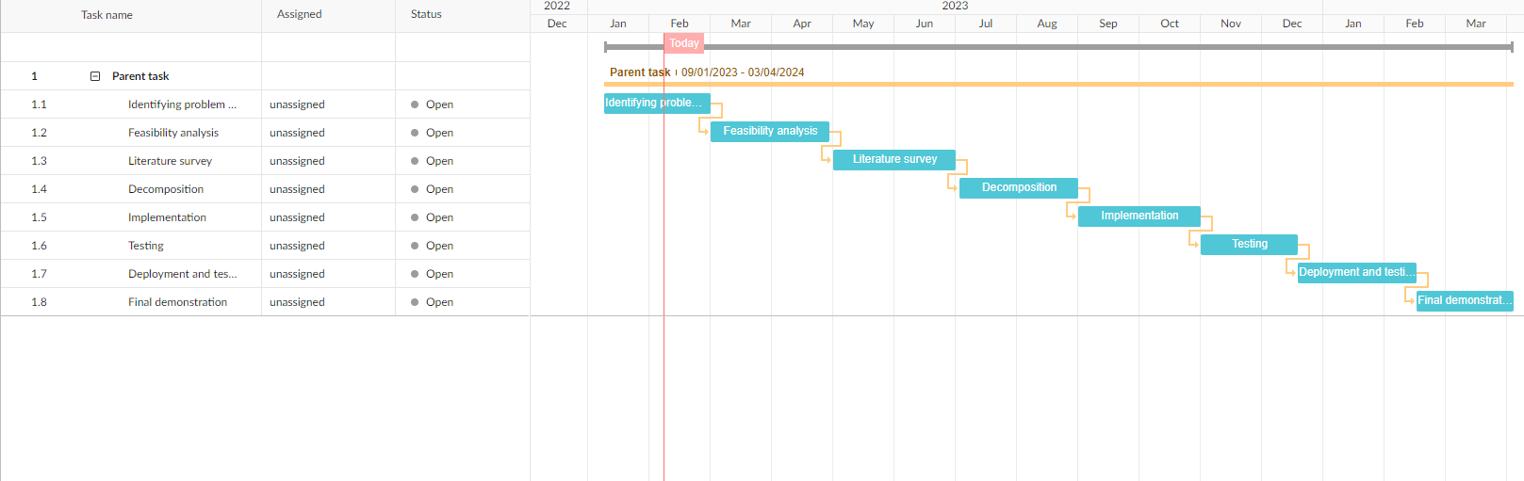
Container and Kubernetes
Capstone (Phase-I & Phase-II) Project Timeline

Slide 8
Container and Kubernetes
Sl. No | Title | Paper Link | Abstract | Solution/ Techniques | Takeaway/ Optimisations
1. | Understanding the Security Implications of Kubernetes Networking F. Minna, A. Blaise, F. Rebecchi, B. Chandrasekaran and F. Massacci, "Understanding the Security Implications of Kubernetes Networking," in IEEE Security & Privacy, vol. 19, no. 5, pp. 46-56, Sept.-Oct. 2021 | 10.1109/MSEC.2021.3094726. | Firewall hole, Hit and spread, replace and propagate type of attacks. | network security, firewall rules, DNS traffic analysis.. | Authentication and encryption.
2. | Koordinator: A Service Approach for Replicating Docker Containers in Kubernetes H. V. Netto, A. F. Luiz, M. Correia, L. de Oliveira Rech and C. P. Oliveira, "Koordinator: A Service Approach for Replicating Docker Containers in Kubernetes," 2018 IEEE Symposium on Computers and Communications (ISCC), Natal, Brazil, 2018, pp. 00058-00063 | https://doi.org/10.1109/ISCC.2018.8538452 | State machine replication scheme for Kubernetes, providing high availability and integrity with strong consistency. Replica coordination is provided as a service, with lightweight coupling to applications. | Replicating container thus improving application availability as failure of replica doesn’t affect the main container and provides better throughput. Forms a service layer on top of that system and not as an integral part of it. | Approach could be used to implement a containerized blockchain with low effort. Coordination is a necessary feature for applications that need to keep their state consistent.

Slide 9
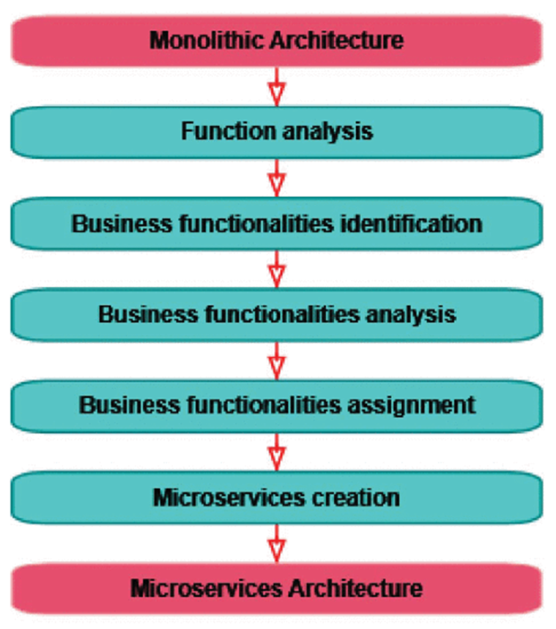
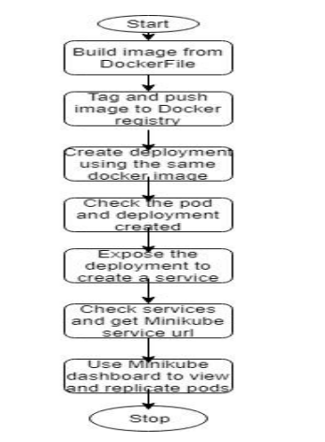
Container and Kubernetes
Sl. No | Title | Paper Link | Abstract | Solution/ Techniques | Takeaway/ Optimisations
3. | From monolithic architecture to microservices architecture L. De Lauretis, "From Monolithic Architecture to Microservices Architecture," 2019 IEEE International Symposium on Software Reliability Engineering Workshops (ISSREW), Berlin, Germany, 2019, pp. 93-96 | 10.1109/ISSREW.2019.00050 | Migration strategy |  | Decomposition and functional assignment to the microservices
4. | SELF-HOSTED KUBERNETES: DEPLOYING DOCKER CONTAINERS LOCALLY WITH MINIKUBE R. Muddinagiri, S. Ambavane and S. Bayas, "Self-Hosted Kubernetes: Deploying Docker Containers Locally With Minikube," 2019 International Conference on Innovative Trends and Advances in Engineering and Technology (ICITAET), Shegoaon, India, 2019, pp. 239-243 | 10.1109/ICITAET47105.2019.9170208. | deploy the container orchestration tool Kubernetes on a local system with a Docker sample container. |  | Applications of using MiniKube with Docker containers: - useful in domains such as finance and healthcare where uploading sensitive customer and patient data to the cloud is a security risk easily scaled to run for the entire organization local testing before deploying
Notes:
Three ways to use kubernatives:
i) Hosted
ii) Self-Hosted - minicubes

Slide 10
Container and Kubernetes
Sl. No | Title | Paper Link | Abstract | Solution/ Techniques | Takeaway/ Optimisations
5. | From Monolithic Systems to Microservices: A Comparative Study of Performance Tapia, F.; Mora, M.Á.; Fuertes, W.; Aules, H.; Flores, E.; Toulkeridis, T. From Monolithic Systems to Microservices: A Comparative Study of Performance. Appl. Sci. 2020, 10, 5797. | https://doi.org/10.3390/app10175797 | An analysis of the two architectures using two different scenarios when both architectures are given same hardware resources and gone through stress tests. (Microservices communicate through the network, which may cause communication failures or, in cases worse, to some slow communications.) | Monolithic Service with KVM. Microservices Architecture running in Containers. | Better results in the following categories : CPU Consumption(negligible difference) Memory Consumption(data is better adjusted) Network Transmission/Reception Optimisations : To improve in disk writing speed which shows finer dispersion of Monolithic Data compare to Microservices which are better adjusted to data. Optimize a collaborative native monolithic tool by migrating it to microservices. With intention to show the strengths and weaknesses of each of these architectures. We are only looking at the techniques used here and try them.

Slide 11
Container and Kubernetes
REFERENCES
Understanding the Security Implications of Kubernetes Networking
F. Minna, A. Blaise, F. Rebecchi, B. Chandrasekaran and F. Massacci, "Understanding the Security Implications of Kubernetes Networking," in IEEE Security & Privacy, vol. 19, no. 5, pp. 46-56, Sept.-Oct. 2021:
10.1109/MSEC.2021.3094726.
From Monolithic Systems to Microservices: A Comparative Study of Performance
Tapia, F.; Mora, M.Á.; Fuertes, W.; Aules, H.; Flores, E.; Toulkeridis, T. From Monolithic Systems to Microservices: A Comparative Study of Performance. Appl. Sci. 2020, 10, 5797.
https://doi.org/10.3390/app10175797
From Monolithic Architecture to Microservices Architecture
L. De Lauretis, "From Monolithic Architecture to Microservices Architecture," 2019 IEEE International Symposium on Software Reliability Engineering Workshops (ISSREW), Berlin, Germany, 2019, pp. 93-96
10.1109/ISSREW.2019.00050

Slide 12
Container and Kubernetes
REFERENCES
SELF-HOSTED KUBERNETES: DEPLOYING DOCKER CONTAINERS LOCALLY WITH MINIKUBE
R. Muddinagiri, S. Ambavane and S. Bayas, "Self-Hosted Kubernetes: Deploying Docker Containers Locally With Minikube," 2019 International Conference on Innovative Trends and Advances in Engineering and Technology (ICITAET), Shegoaon, India, 2019, pp. 239-243
10.1109/ICITAET47105.2019.9170208.
Koordinator: A Service Approach for Replicating Docker Containers in Kubernetes
H. V. Netto, A. F. Luiz, M. Correia, L. de Oliveira Rech and C. P. Oliveira, "Koordinator: A Service Approach for Replicating Docker Containers in Kubernetes," 2018 IEEE Symposium on Computers and Communications (ISCC), Natal, Brazil, 2018, pp. 00058-00063
https://doi.org/10.1109/ISCC.2018.8538452

Slide 13

Thank You

